Slide 1



Slide 2

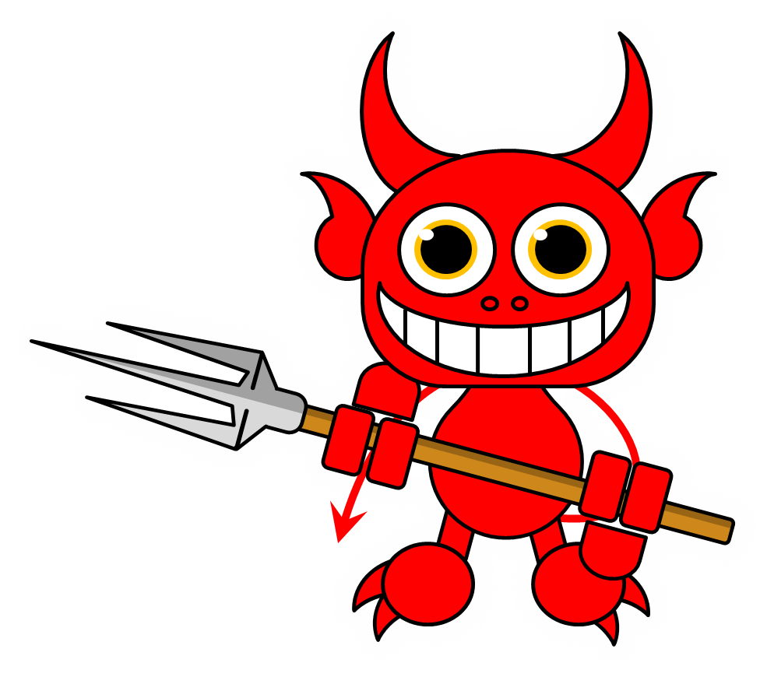
Must authenticate your sensors so that tampering can be detected!
Couldn’t you have told me earlier?!

Slide 3


Authentication by Secret Questions
Give me your A/C number and answer the following questions
What is your date of birth?
What is your pet’s name?
How many marks did you get in 10th standard exams?
How many cars do you own?
…
SBI31415926535
05th August 2000
Mr. Bud Bud
err … couldn’t hear you clearly
None, so give me that loan already!
…
BANK
USER

Slide 4

Authentication by Secret Questions
Using PUFs
Give me your device ID and answer the following questions
10111100
00110010
10001110
00010100
…
TS271828182845
1
0
1
0
…
SERVER
DEVICE
How to ensure that these answers are unique and unpredictable?

Slide 5


Physically Unclonable Functions
0.50ms
These tiny differences are difficult to predict or clone
0.55ms
Then these could act as the fingerprints for the devices!

Slide 6

A simple Multiplexer PUF
Multiplexers are basically switching circuits
“select” bit
0
1
Correct. However, the devices are consistent, i.e., their delays do not change (too much) over time.
p ms delay
r ms delay
s ms delay
q ms delay
It is difficult to deliberately create another mux that exhibits the same delays

Slide 7
Arbiter PUFs
If the top signal reaches the finish line first, the “answer” to this question is 0, else if the bottom signal reaches first, the “answer” is 1
Question: 1011
1
0
1
1
?

Slide 8
Arbiter PUFs
If the top signal reaches the finish line first, the “answer” to this question is 0, else if the bottom signal reaches first, the “answer” is 1
Question: 1011
1
0
1
1
1
?

Slide 9
Arbiter PUFs
If the top signal reaches the finish line first, the “answer” to this question is 0, else if the bottom signal reaches first, the “answer” is 1
Question: 0110
0
1
1
0
0
?

Slide 10


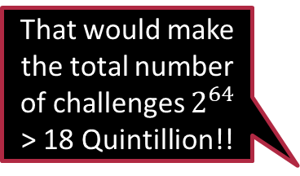
Some FAQs
Does it matter whether the “red” signal reaches first or the “blue”?
No, the color does not matter – the color was added just for explanation
Why go into all this fuss of having multiple multiplexers?
It was expected that it would make it more difficult to predict the answers. Also, it increases the number of possible questions.
Is it compulsory to have only 4 multiplexers?
Absolutely not. It depends on how long are your “questions”
That would make the total number of challenges $2^{64}$ > 18 Quintillion!!
It is common to have 64 multiplexers
Good … even if an attacker knows the responses to a few challenges, there is no way to guess the other answers. Right? Right? Hello! Melbo!!
By the way, people usually call the questions “challenges” and the answers “responses”
Actually …

Slide 11









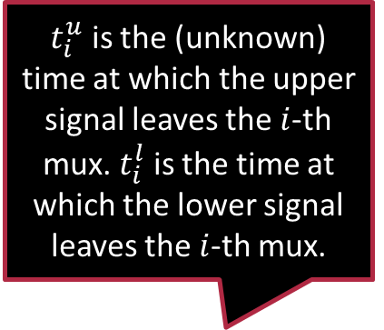






















A Twist in the Tale
$t_{i}^{u}$ is the (unknown) time at which the upper signal leaves the $i$-th mux. $t_{i}^{l}$ is the time at which the lower signal leaves the $i$-th mux.
An attacker can see responses on a few challenges and use ML to predict responses on all other challenges ☹
Does not matter if using 32-bit or 64-bit challenges
All mux-es are different so $p_{1}≠p_{2}≠…,q_{1}≠q_{2}≠…$
$$c_{0}$$
$$c_{1}$$
$$c_{2}$$
$$c_{63}$$
$$t_{0}^{u}$$
$$t_{1}^{u}$$
$$…$$
$$t_{2}^{u}$$
$$t_{63}^{u}$$
$$p_{0}$$
$$p_{1}$$
$$p_{2}$$
$$p_{63}$$
$$r_{0}$$
$$r_{1}$$
$$r_{2}$$
$$r_{63}$$
$$s_{0}$$
$$s_{1}$$
$$s_{2}$$
$$…$$
$$t_{0}^{l}$$
$$t_{1}^{l}$$
$$t_{2}^{l}$$
$$s_{63}$$
$$t_{63}^{l}$$
$$q_{0}$$
$$q_{1}$$
$$q_{2}$$
$$q_{63}$$

Slide 12

A Twist in the Tale
Observe that the answer is $0$ if $t_{63}^{u}<t_{63}^{l}$ and $1$ otherwise
Also note that $t_{1}^{u}$ and $t_{1}^{l}$ depend on $t_{0}^{u},t_{0}^{l},p_{1},q_{1},r_{1},s_{1}$ and $c_{1}$
$c_{1}$ dictates which previous delay $t_{0}^{u}$ or $t_{0}^{l}$ will get carried forward in which branch, and $p_{1},q_{1},r_{1},s_{1}$ give us the delay introduced by the $1$-th mux itself
$$c_{0}$$
$$c_{1}$$
$$c_{2}$$
$$c_{63}$$
$$t_{0}^{u}$$
$$t_{1}^{u}$$
$$…$$
$$t_{2}^{u}$$
$$t_{63}^{u}$$
$$p_{0}$$
$$p_{1}$$
$$p_{2}$$
$$p_{63}$$
$$r_{0}$$
$$r_{1}$$
$$r_{2}$$
$$r_{63}$$
$$s_{0}$$
$$s_{1}$$
$$s_{2}$$
$$…$$
$$t_{0}^{l}$$
$$t_{1}^{l}$$
$$t_{2}^{l}$$
$$s_{63}$$
$$t_{63}^{l}$$
$$q_{0}$$
$$q_{1}$$
$$q_{2}$$
$$q_{63}$$

Slide 13
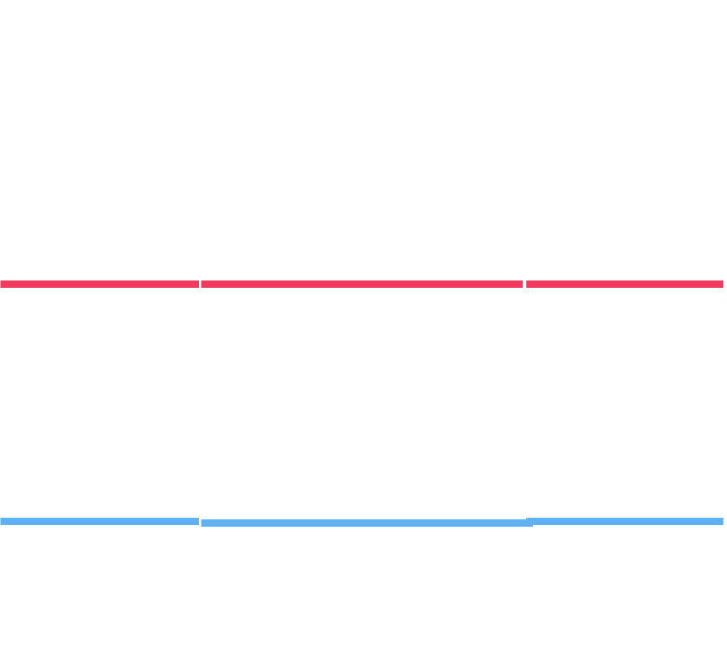
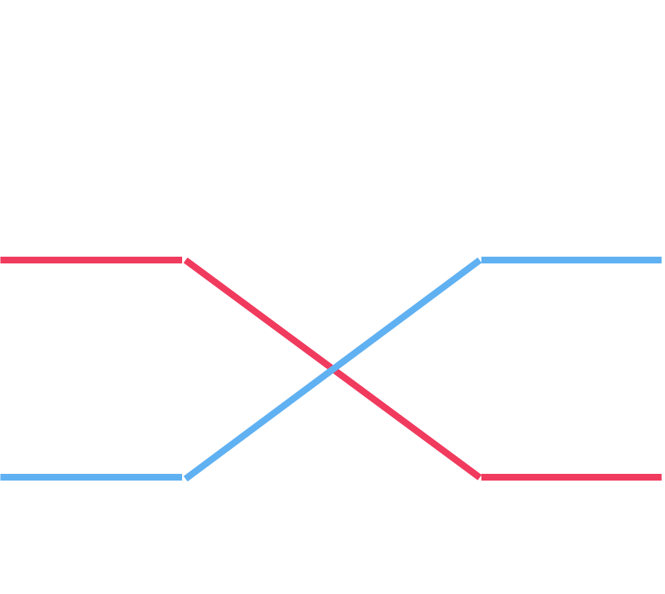











A Twist in the Tale
$$0$$
$$1$$
$$1$$
$$0$$
$t_{1}^{u}=\left(1−c_{1}\right)⋅\left(t_{0}^{u}+p_{1}\right)+c_{1}⋅\left(t_{0}^{l}+s_{1}\right)$
$t_{1}^{l}=\left(1−c_{1}\right)⋅\left(t_{0}^{l}+q_{1}\right)+c_{1}⋅\left(t_{0}^{u}+r_{1}\right)$
$$1$$
$$0$$
$$1$$
$$0$$
$$c_{0}$$
$$c_{1}$$
$$c_{2}$$
$$c_{63}$$
$$0$$
$$1$$
$$t_{0}^{u}$$
$$t_{1}^{u}$$
$$…$$
$$t_{2}^{u}$$
$$t_{63}^{u}$$
$$p_{0}$$
$$p_{1}$$
$$p_{2}$$
$$p_{63}$$
$$r_{0}$$
$$r_{1}$$
$$r_{2}$$
$$r_{63}$$
$$s_{0}$$
$$s_{1}$$
$$s_{2}$$
$$…$$
$$t_{0}^{l}$$
$$t_{1}^{l}$$
$$t_{2}^{l}$$
$$s_{63}$$
$$t_{63}^{l}$$
$$q_{0}$$
$$q_{1}$$
$$q_{2}$$
$$q_{63}$$

Slide 14
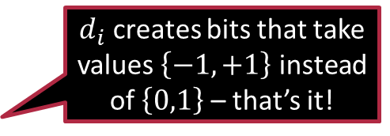

A little bit of Math ☺
Let us use the shorthand $Δ_{i}=t_{i}^{u}−t_{i}^{l}$ to denote the lag
Recall: all that matters is whether the top signal reaches first or not
Thus, all that matters is whether $Δ_{63}<0$ or not
$Δ_{1}=\left(1−c_{1}\right)⋅\left(t_{0}^{u}+p_{1}−t_{0}^{l}−q_{1}\right)+c_{1}⋅\left(t_{0}^{l}+s_{1}−t_{0}^{u}−r_{1}\right)$
$=\left(1−c_{1}\right)⋅\left(Δ_{0}+p_{1}−q_{1}\right)+c_{1}⋅\left(−Δ_{0}+s_{1}−r_{1}\right)$
$=\left(1−2c_{1}\right)⋅Δ_{0}+\left(q_{1}−p_{1}+s_{1}−r_{1}\right)⋅c_{1}+\left(p_{1}−q_{1}\right)$
To make notation simpler, let $d_{i}≝\left(1−2c_{i}\right)$
$Δ_{1}=Δ_{0}⋅d_{1}+α_{1}⋅d_{1}+β_{1}$ $α_{1}=\left(p_{1}−q_{1}+r_{1}−s_{1}\right)/2$ $β_{1}=\left(p_{1}−q_{1}−r_{1}+s_{1}\right)/2$
$d_{i}$ creates bits that take values $\left\{−1,+1\right\}$ instead of $\left\{0,1\right\}$ – that’s it!

Slide 15

A little bit of Math ☺
Note that a similar relation holds for any stage $Δ_{i}=d_{i}⋅Δ_{i−1}+α_{i}⋅d_{i}+β_{i}$
where $α_{i}=\left(p_{i}−q_{i}+r_{i}−s_{i}\right)/2$ and $β_{i}=\left(p_{i}−q_{i}−r_{i}+s_{i}\right)/2$
We can safely take $Δ_{−1}=0$ (absorb initial delays into $p_{0},q_{0},r_{0},s_{0}$)
We can keep going on recursively $Δ_{0}=α_{0}⋅d_{0}+β_{0}$ (since $Δ_{−1}=0$)
$Δ_{1}=Δ_{0}⋅d_{1}+α_{1}⋅d_{1}+β_{1}$ – now plugin value of $Δ_{0}$ to get
$Δ_{1}={α_{0}⋅d}_{1}⋅d_{0}+\left(α_{1}+β_{0}\right)⋅d_{1}+β_{1}$
$Δ_{2}=α_{0}⋅d_{2}⋅d_{1}⋅d_{0}+\left(α_{1}+β_{0}\right)⋅d_{2}⋅d_{1}+\left(α_{2}+β_{1}\right)⋅d_{2}+β_{2}$
We can begin to see a pattern here

Slide 16



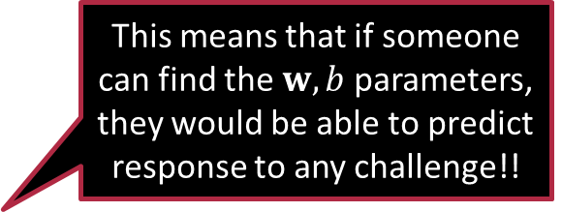
Linear Models
We have $Δ_{63}=w_{0} ⋅x_{0}+w_{1}⋅x_{1}+…+w_{63}⋅x_{63}+β_{63}=w^{⊤}x+b$
where $x_{i}=d_{i}⋅d_{i+1}⋅…⋅d_{63}$ $w_{0}=α_{0}$ $w_{i}=α_{i}+β_{i−1} \left(for i>0\right)$
If $Δ_{63}<0$, upper signal wins and answer is 0
If $Δ_{63}>0$, lower signal wins and answer is 1
Thus, answer is simply $\frac{sign\left(w^{⊤}x+b\right)+1}{2}$
Exactly, this is why people stopped using arbiter PUFs for authentication after this was revealed
This means that if someone can find the $w,b$ parameters, they would be able to predict response to any challenge!!
This is nothing but a linear classifier!

Slide 17


Linear/hyperplane Classifiers
The model is a single vector $w$ of dimension $d$ (features are also $d$-dim), and a scalar term (called bias) $b$
Predict on a test point $x$ by checking if $w^{⊤}x+b>0$
Decision boundary: hyperplane (where $w^{⊤}x+b=0$)
The vector $w$ is called the normal or perpendicular vector of the hyperplane – why?
Consider any two vectors $x,y$ on the hyperplane i.e. $w^{⊤}x+b=0=w^{⊤}y+b$. This means $w^{⊤}(x−y)=0$. Note that the vector $x−y$ is parallel to the hyperplane and $w$ perpendicular to all such vectors
The bias term $b$ if changed, shifts the plane – it can be thought of as a threshold as well – how large does $w^{⊤}x$ have to be in order for decision to be 1
$$w$$

Slide 18
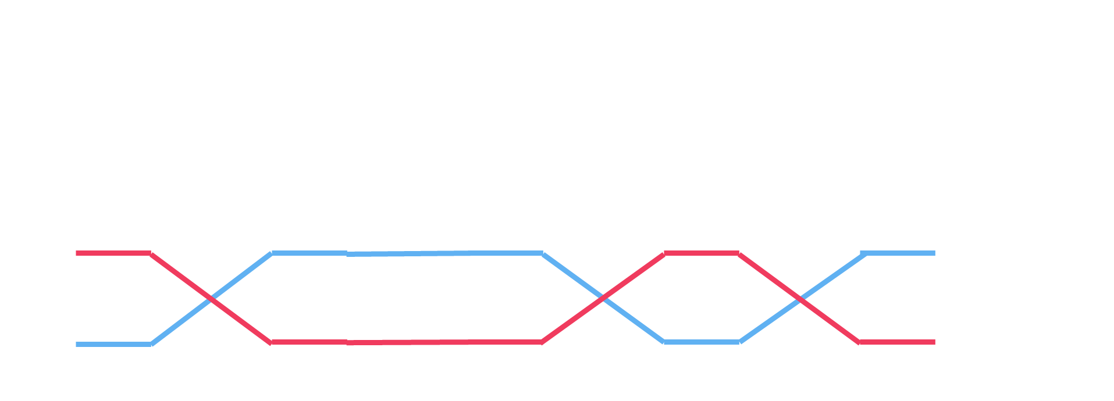
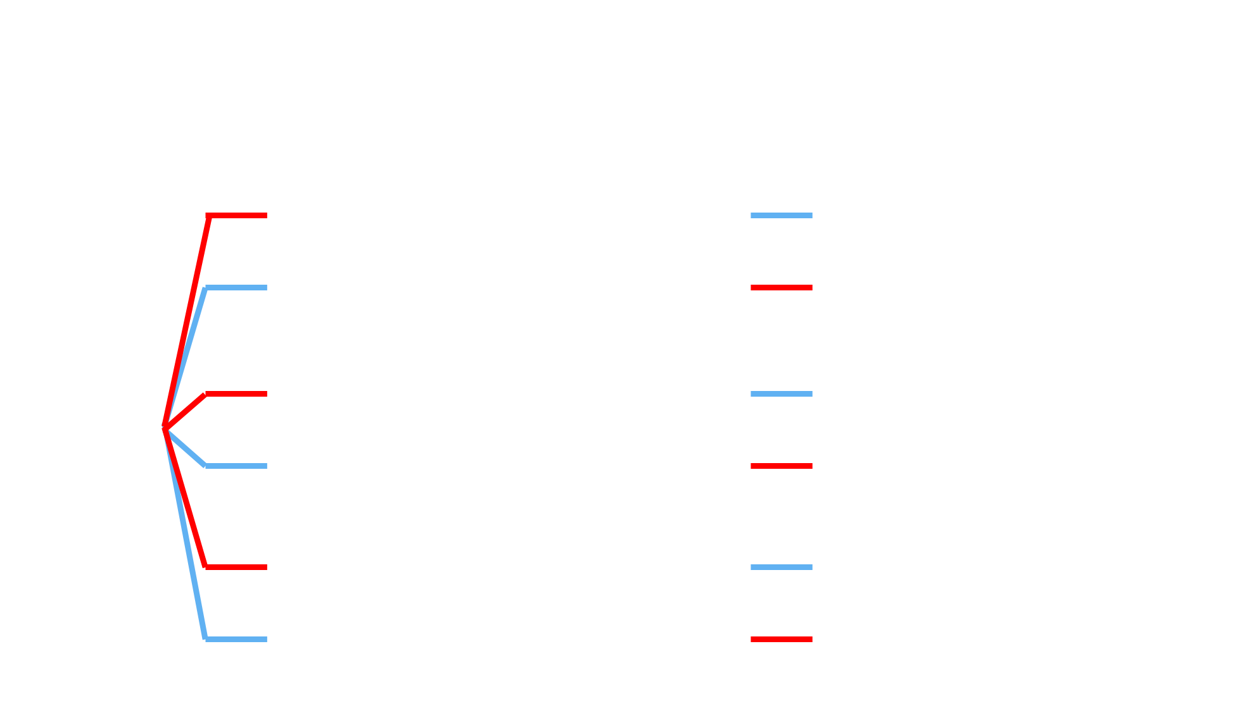

XOR PUF
XOR: given a bunch of 0/1 bits, output is 1 if odd number of bits are 1 else if even number of bits (includes no bits) are 1, output is 0
XOR is basically addition modulo 2 $\left(b_{1}+…+b_{K}\right)\%2$

Slide 19

Cracking the XOR PUF
It turns out that the XOR PUF can also be cracked using a linear model although one of a larger dimensionality
Key insight: if we have a bunch of $+1/−1$ values, their product is +1 if and only if an even number of them are -1 else the product is -1
We can crack the individual PUFs using linear models i.e., for i-th PUF $\frac{1+sign\left(w_{i}^{⊤}x\right)}{2}$
Remember: sign value of +1 corresponds to bit 1 and -1 corresponds to bit 0
Note: $\prod_{i}{sign\left(w_{i}^{⊤}x\right)}$ is +1 if an even number of the sign values are -1
However, XOR is concerned with parity of +1 bits
Solution: Flip the signs!

Slide 20

Cracking the XOR PUF
The product $−\prod_{i}{−sign\left(w_{i}^{⊤}x\right)}={\left(−1\right)}^{K+1}\prod_{i}{sign\left(w_{i}^{⊤}x\right)}$ is -1 if an even number of the sign values are +1 else the product is +1
The extra $−1$ is there since XOR is $0$ if there are an even number of $1$s
Here, $K$ is the number of PUFs
Thus, the output of $\frac{\left(1+{\left(−1\right)}^{K+1}\prod_{i}{sign\left(w_{i}^{⊤}x\right)}\right)}{2}$ is 0 if an even number of the sign values are +1 else the output is 1
This is exactly what we wanted!
All we need to do find a way to compute $\prod_{i}{sign\left(w_{i}^{⊤}x\right)}$
Although it does not seem so right away, there is a linear model hidden here
Observation: $\prod_{i}{sign\left(w_{i}^{⊤}x\right)}=sign\left(\prod_{i}{\left(w_{i}^{⊤}x\right)}\right)$
Find a way to simplify $\prod_{i}{\left(w_{i}^{⊤}x\right)}$

Slide 21

Cracking the XOR PUF
Let’s take a toy example in 2 dims with $\left(w_{1}^{⊤}x\right)⋅\left(w_{2}^{⊤}x\right)$ where $w_{1}=\left(a,b\right),w_{2}=\left(p,q\right),x=\left(x,y\right)∈ℝ^{2}$ $\left(w_{1}^{⊤}x\right)⋅\left(w_{2}^{⊤}x\right)=\left(ax+by\right)⋅\left(px+qy\right)$ $=ap⋅x^{2}+\left(aq+bp\right)⋅xy+bq⋅y^{2}$ $=W^{⊤}X,$
where $W=\left(ap, aq+bp,bq\right),X=\left(x^{2},xy,y^{2}\right)∈ℝ^{3}$
Thus, we can just learn a linear model in 3D instead of 2D
Exercise: extend this intuition to more than 2 classifiers and higher dims
Try to do optimizations to reduce the dimensionality of $X$
Note: we are not assured that the linear model we learn will be of this form i.e., for some $a,b,p,q$ we get $\left(ap, aq+bp,bq\right)$
However, we are assured that a linear model with 0 error does exist

Slide 22


AND PUF
AND: given a bunch of 0/1 bits, output is 1 if all the bits are 1 else if even one of them is 0, the output is 0
Hint: the quantity $\frac{1+sign\left(w^{⊤}x\right)}{2}$
would be of relevance

Slide 23
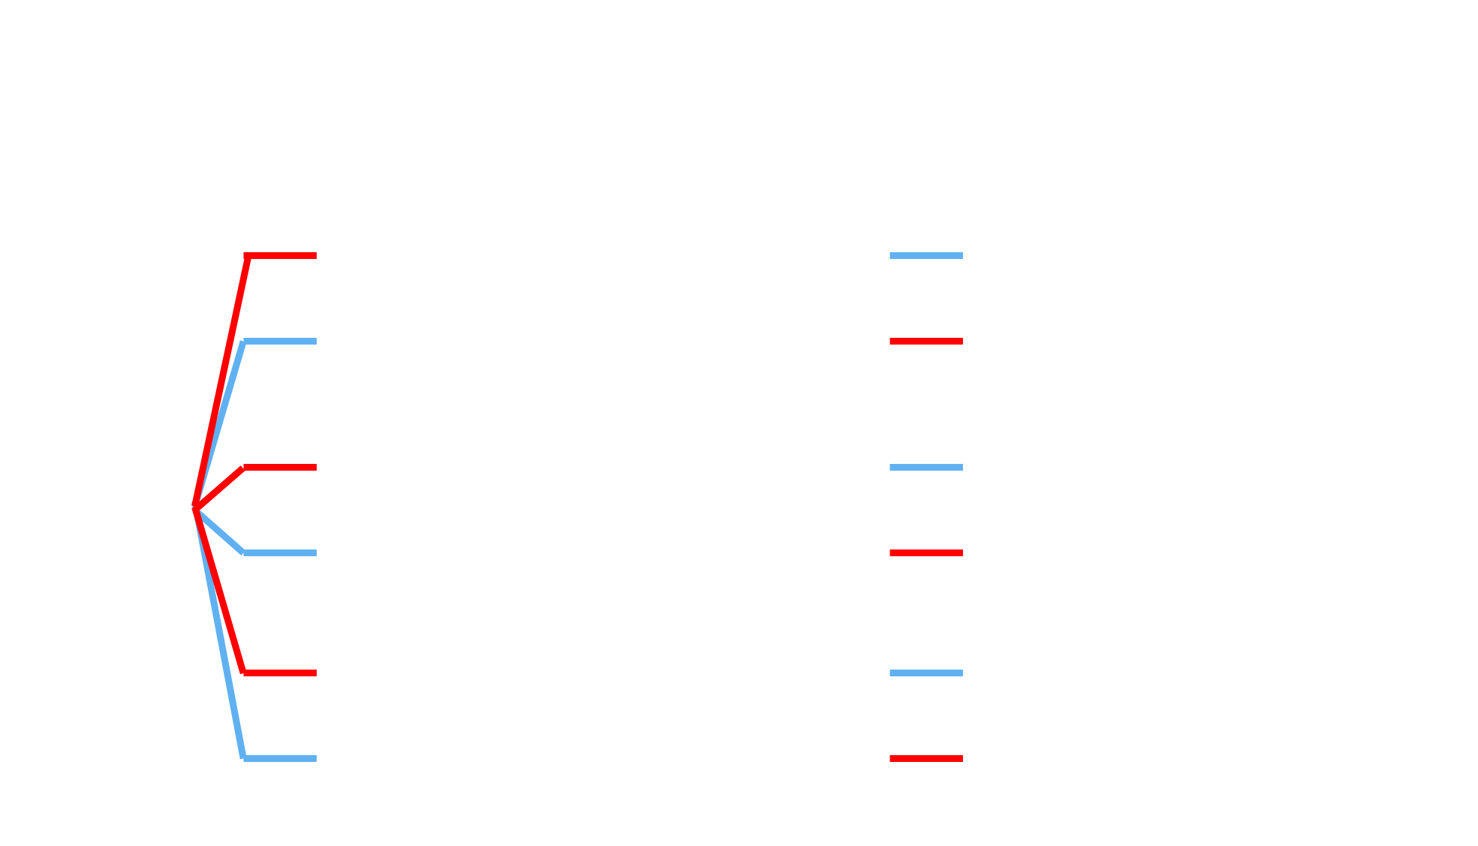

OR PUF
OR: given a bunch of 0/1 bits, output is 1 if even one of the bits is 1 else output is 0 if all bits are 0
Hint: the quantity $\frac{1+sign\left(w^{⊤}x\right)}{2}$
would be of relevance

